Slide 1
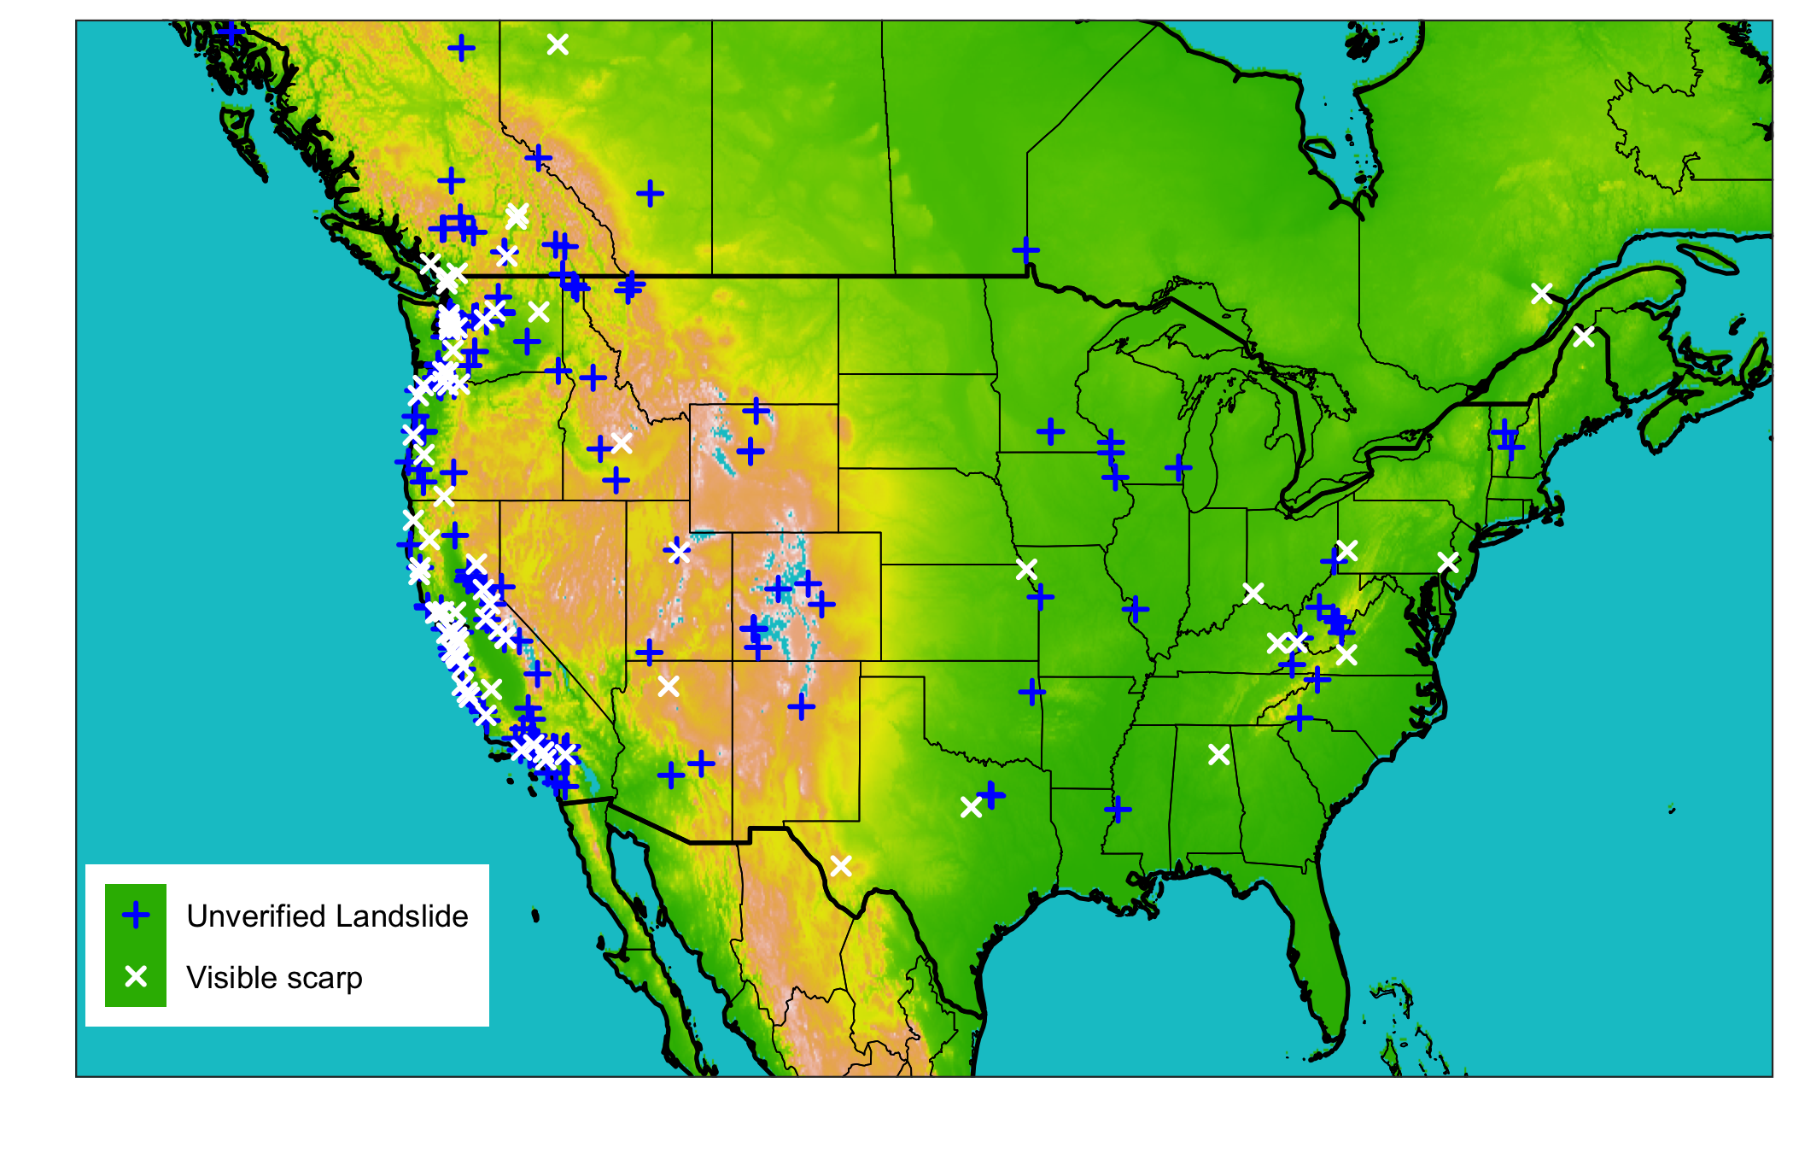
FIGURE 1: map of sites with overlaid graphs showing precipitation product comparison for select sites for ‘typical' storms

Slide 2
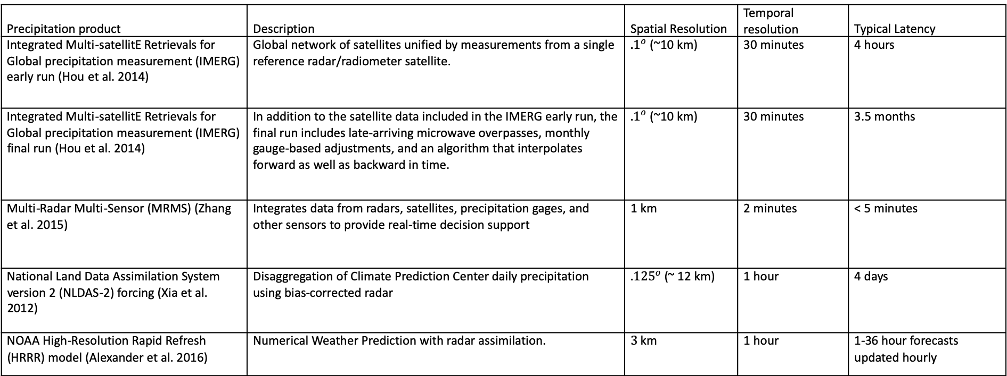
TABLE 1: precipitation products
Precipitation product | Description | Spatial Resolution | Temporal resolution | Typical Latency
Integrated Multi-satellitE Retrievals for Global precipitation measurement (IMERG) early run (Hou et al. 2014) | Global network of satellites unified by measurements from a single reference radar/radiometer satellite. | ${.1}^{o}$ (~10 km) | 30 minutes | 4 hours
Integrated Multi-satellitE Retrievals for Global precipitation measurement (IMERG) final run (Hou et al. 2014) | In addition to the satellite data included in the IMERG early run, the final run includes late-arriving microwave overpasses, monthly gauge-based adjustments, and an algorithm that interpolates forward as well as backward in time. | ${.1}^{o}$ (~10 km) | 30 minutes | 3.5 months
Multi-Radar Multi-Sensor (MRMS) (Zhang et al. 2015) | Integrates data from radars, satellites, precipitation gages, and other sensors to provide real-time decision support | 1 km | 2 minutes | < 5 minutes
National Land Data Assimilation System version 2 (NLDAS-2) forcing (Xia et al. 2012) | Disaggregation of Climate Prediction Center daily precipitation using bias-corrected radar | ${.125}^{o}$ (~ 12 km) | 1 hour | 4 days
NOAA High-Resolution Rapid Refresh (HRRR) model (Alexander et al. 2016) | Numerical Weather Prediction with radar assimilation. | $3$ km | 1 hour | 1-36 hour forecasts updated hourly

Slide 3
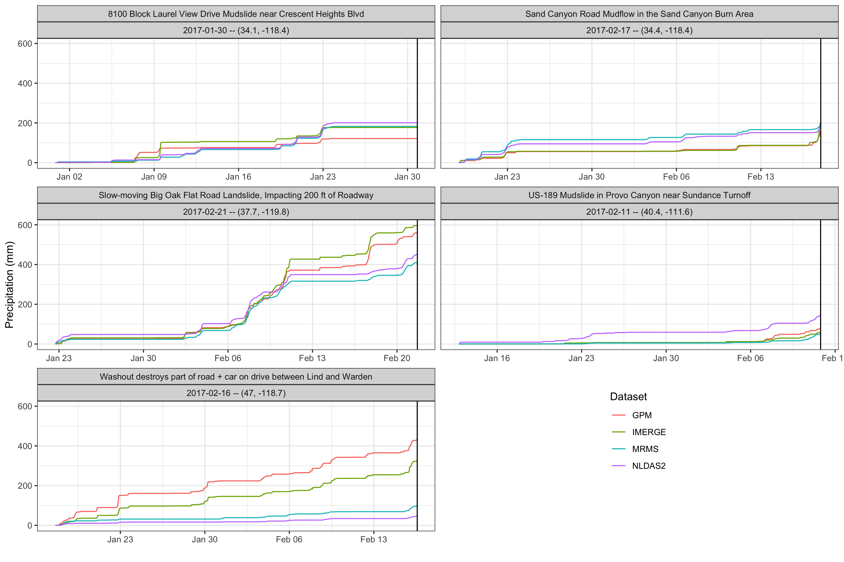
FIGURE 2: Cumulative precipitation comparison for select sites

Slide 4
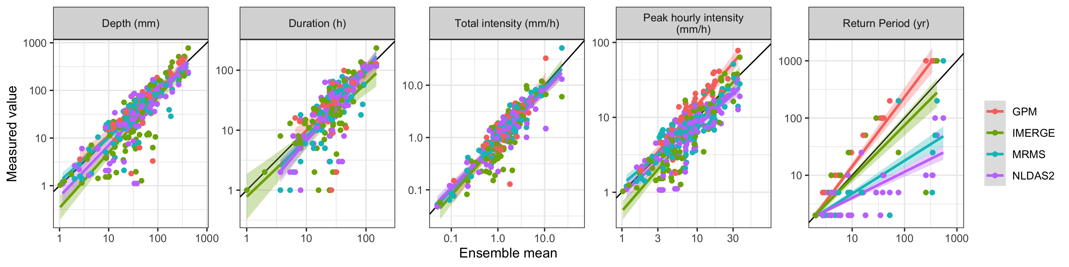
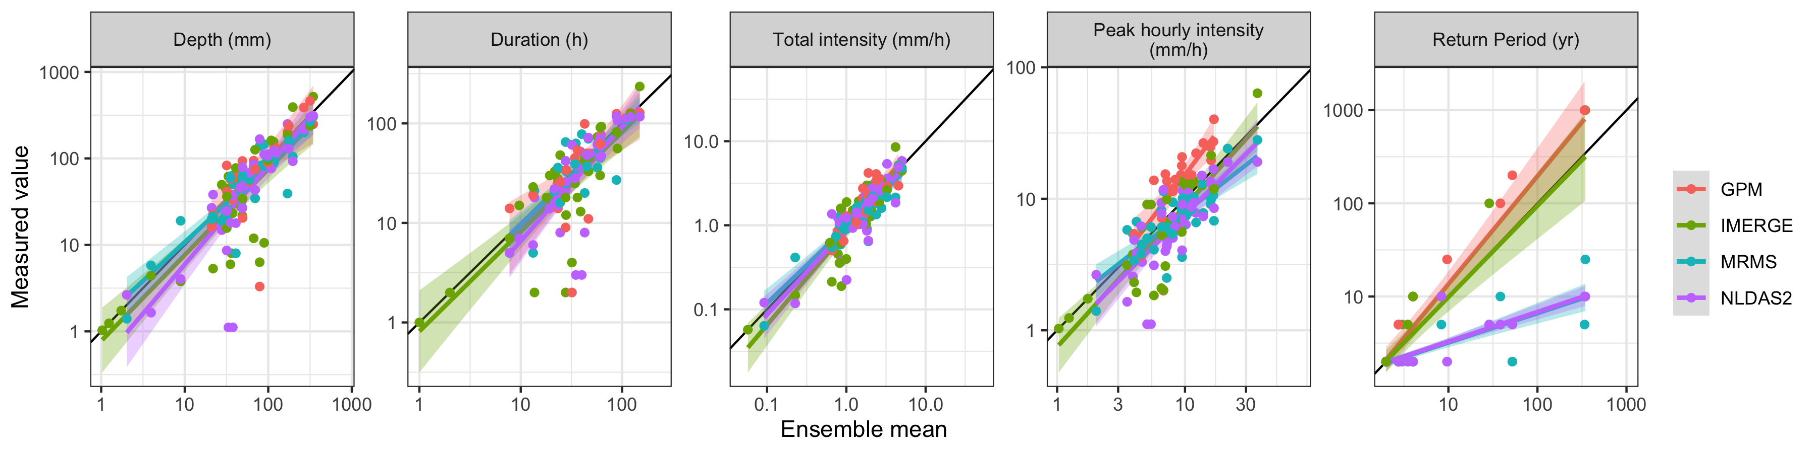
FIGURE 3: Scatter volume, intensity, frequency, and peak intensity for each product against the ensemble mean
All Landslides
Verified exact
locations only
Notes:
IMERG Final has clearly higher peak intensity values; this is reflected in the return period
IMERG Early has similar values to IMERG Final for most events, but also contains more noise; it appears that the Final algorithm eliminates altogether a number of storms that show up as low values in the Early version, but that the larger storms match more closely but tend to be slightly larger in the Final version
Verified locations only eliminates a lot of the noise in precipitation depth and duration from IMERGE in particular – barely above threshold precipitation events probably did not trigger landslide

Slide 5
TABLE 2: Bias and variability for volume and intensity for each product; for exact locations only; and for matched spatial/temporal/both resolutions
 | All data, original resolution |  | Exact locations only |  | Matching spatial resolution |  | Matching temporal resolution |  | Matching resolution
 | Volume | Intensity | Volume | Intensity | Volume | Intensity | Volume | Intensity | Volume | Intensity
GPM IMERG Early | Bias (Variability)
GPM IMERG Final
NLDAS-2
HRRR
MRMS

Slide 6
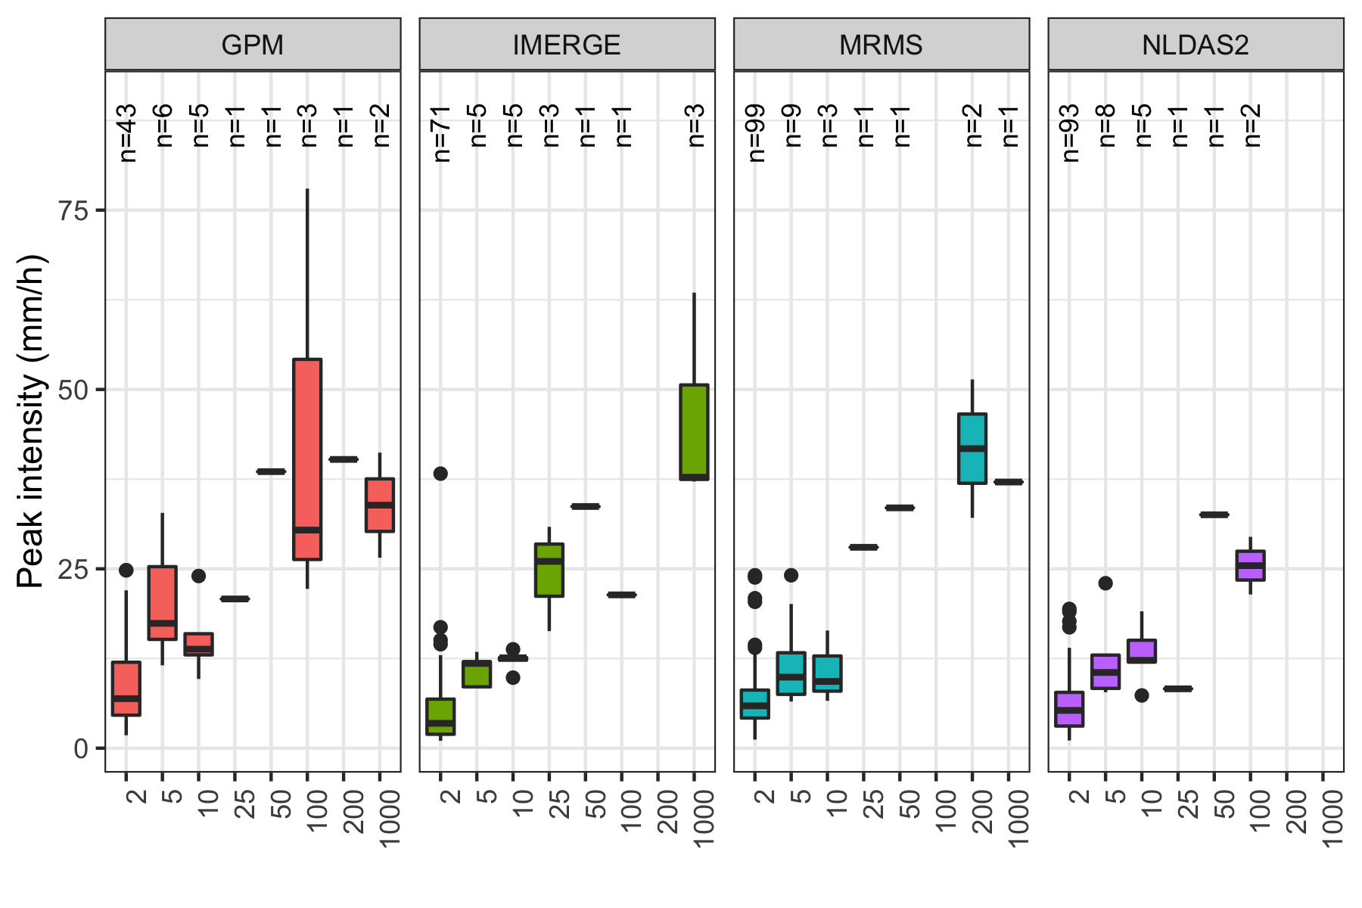
FIGURE 4: Precipitation frequency vs. peak intensity for landslide-triggering storm by site by product

Slide 7
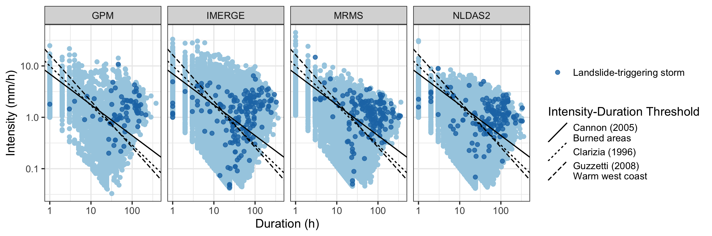
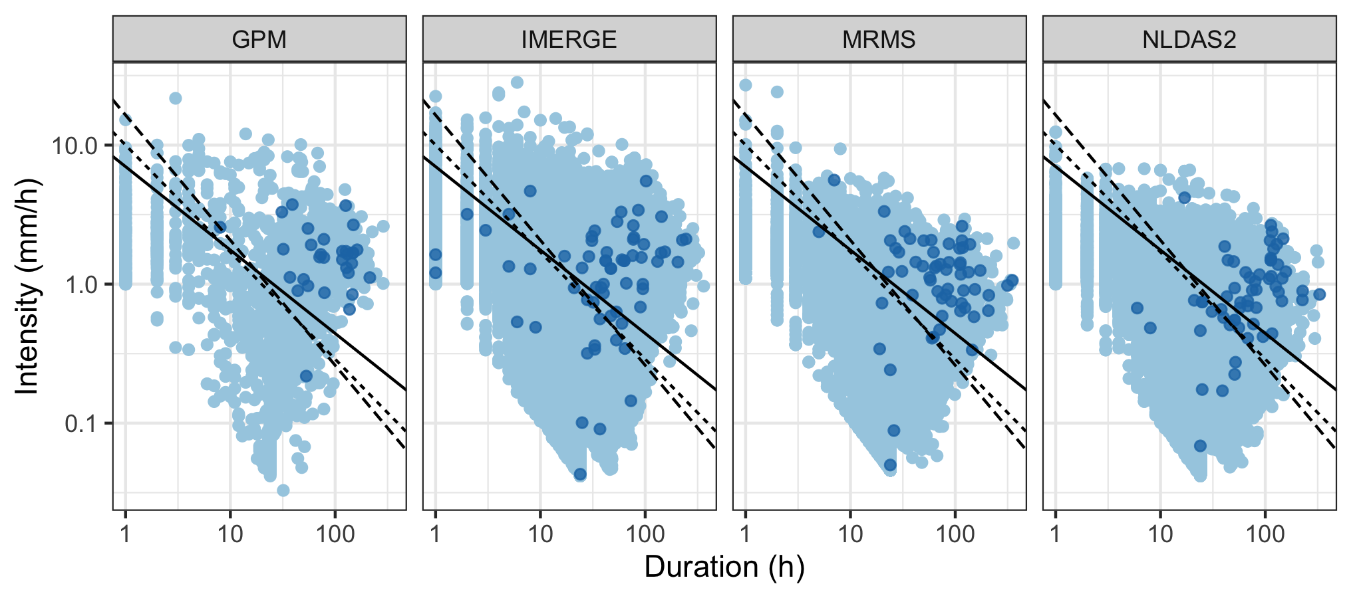
FIGURE 5: Example Intensity-Duration Threshold with multiple precipitation products plotted on top, landslide-triggering events in bold
All Landslides
Verified exact
locations only
Notes:
Models appear to perform better with landslides with verified locations
MRMS and IMERG Early have more low intensity, medium duration storms triggering landslides than other products
Choice of precipitation product appears to make more of a difference than the choice of model
Burned are model allows for lower intensity, lower duration storms and misses lower intensity higher duration storms, but most of these storms are longer than 10 hours

Slide 8
TABLE 2: True positives, true negatives, false positives, false negatives, and threat score for each product and threshold (For exact locations only and matched resolutions in parentheses)
 | True positives | True negatives | False positives | False negatives | Threat score
GPM IMERG Early | Total (Exact, Matched resolution)
GPM IMERG Final
NLDAS-2
HRRR
MRMS

Slide 9
FIGURE 8: Scatter volume, intensity, frequency, and peak intensity for each product with matched spatial resolution, temporal resolution, and both

Slide 10
FIGURE 9: Intensity-Duration Threshold example for each product with matched spatial resolution, temporal resolution, and both

